Slide 1
Credit One Loan Default Analysis
Andres Saucedo
4/15/2020

Slide 2

Project Objectives
Goal 1. Client Needs
Goal 2. Data Science Process Framework
Goal 3. Data Management
Goal 4. Initial Insights
Understanding client needs is fundamental to business operations. Will further examine the needs of Credit One.
Select, tailor, and instantiate a process framework appropriate for successful analysis.
Explanation of how we will manage the data. Address potential issues. Flowchart visualizing the detailed process of data management.
Initial Exploratory analysis

Slide 3

Goal 1- Understanding Client Needs
Client = Credit One
Background:
Credit One is a credit risk rating company. its 'business partners' use their services to identify possible risks in the profile of one of their clients prior to granting a loan. Recently, Credit One has seen an increase in the number of customers who have defaulted on loans granted by their business partners, and Credit One as a credit rating could risk losing business if the problem is not resolved correctly.
Goal:
Predict defaulting, using statistics, machine learning through Python. By being able to predict defaulting, we can lower customer default rates and mitigate business loss for Credit One.

Slide 4
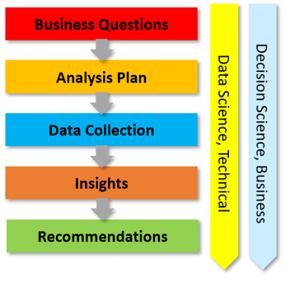
Goal 2. Data Science Process Framework
Business question
- What is the stated business question?
Analysis plan
- What is the analysis goal?
Data collection
- From where can the data be obtained?
Insights
- What patterns do we see in the data?
Recommendation
- What is recommended to the client?
Framework Two - BADIR

Slide 5

Goal 3. Data Management
Location of Data Sources:
https://archive.ics.uci.edu/ml/datasets/default+of+credit+card+clients
Data Features:
This research employed a binary variable, default payment (Yes = 1, No = 0), as the response variable.
X1: Amount of the given credit (NT dollar): it includes both the individual consumer credit and his/her family (supplementary) credit.
X2: Gender (1 = male; 2 = female).
X3: Education (1 = graduate school; 2 = university; 3 = high school; 4,5,6 = others).
X4: Marital status (1 = married; 2 = single; 3 = others).
X5: Age (year).
X6 - X11: History of past payment
X12-X17: Amount of bill statement (NT dollar).
X18-X23: Amount of previous payment (NT dollar).
Notes:
Used a Random Forest model

Slide 6
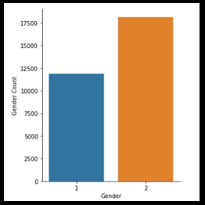
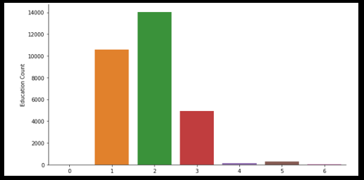
Goal 4. Initial Insights
Gender:
1: Male
2: Female
Education Level:
Education (1 = graduate school; 2 = university; 3 = high school; 4,5,6 = others).
Notes:
We can see on the graph to the left the number of transactions on the x-axis and the frequency on the Y axis. Interpreting this graph, A transaction that occurred alone, occurred 2163 times, 2 transactions occurred 1647 times, 3 transactions occurred 1294 times, etc. Additionally, it is abundantly clear that many items and accessories were bundled and purchased together, so we can conclude that the primary type of business that Electronidex is Business to Business
On the right, If the condition is fulfilled, then the result is produced. OR If Items in the item set are purchased, then Item on the right-hand side is likely to be purchased too. So we are 81% confident that if Acer Inspire, Dell Desktop and ViewSonic Monitor were purchased together, an HP laptop likely will be purchased as well.

